Slide 1

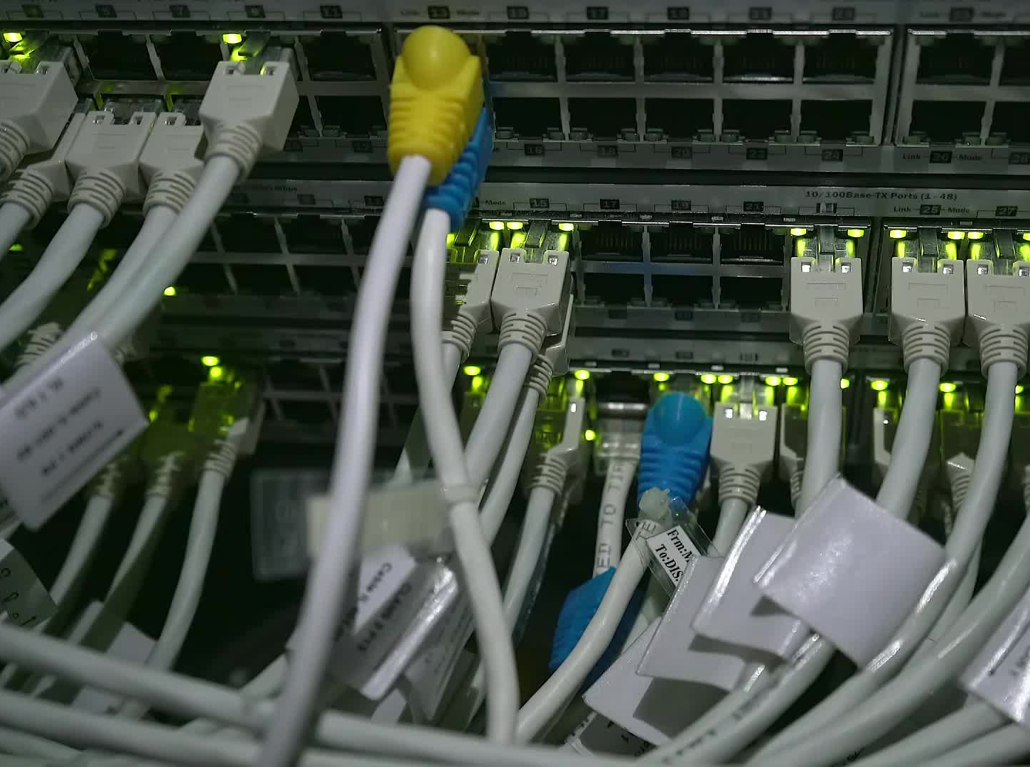


CS621 Parallel and Distributed Computing
Dr. Muhammad Anwaar Saeed
Dr. Said Nabi
Ms. Hina Ishaq

Slide 2
CS621 Parallel and Distributed Computing
Introduction To Message Passing

Slide 3
Objectives
Introduction to Message Passing.
Message Passing Model.

Slide 4
Introduction to Message Passing
“Message passing is a method of communication in distributed systems where processes or objects exchange messages with each other to share information or coordinate activities.”

Slide 5
Message Passing Model
Message passing is the most commonly used parallel programming approach in distributed memory systems. Here, the programmer has to determine the parallelism. In this model, all the processors have their own local memory unit and they exchange data through a communication network.
There are two main types of message passing: synchronous and asynchronous.

Slide 6


Message Passing Model Cont…
Processors use message-passing libraries for communication among themselves. Along with the data being sent, the message contains the following components:
The address of the processor from which the message is being sent.
Starting address of the memory location of the data in the sending processor.
Data type of the sending data.
Data size of the sending data.
The address of the processor to which the message is being sent.
Starting address of the memory location for the data in the receiving processor.

Slide 7
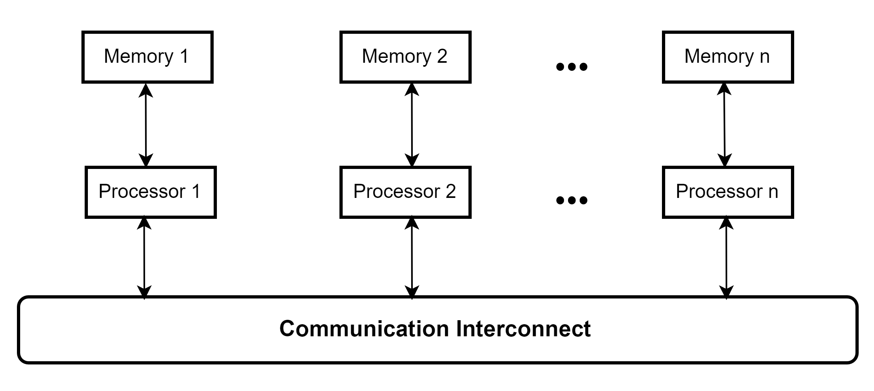
Message Passing Model Cont…

Slide 8
Message Passing Model Cont…
The message passing model demonstrates the following characteristics:
A set of tasks that use their own local memory during computation. Multiple tasks can reside on the same physical machine as well across an arbitrary number of machines.
Tasks exchange data through communications by sending and receiving messages.
Data transfer usually requires cooperative operations to be performed by each process. For example, a send operation must have a matching receive operation.

Slide 9
CS621 Parallel and Distributed Computing
What is Message Passing Interface (MPI)?

Slide 10
Objectives
Understanding of Message Passing Interface (MPI).
History and Versions of MPI.

Slide 11
Message Passing Interface
A process is (traditionally) a program counter and address space.
Processes may have multiple threads (program counters and associated stacks) sharing a single address space. MPI is for communication among processes, which have separate address spaces.
Inter-process communication consists of:
Synchronization
Movement of data from one process’s address space to another’s.

Slide 12
Message Passing Interface Cont…
Types of Parallel Computing Models:
Data Parallel - the same instructions are carried out simultaneously on multiple data items (SIMD)
Task Parallel - different instructions on different data (MIMD)
SPMD (single program, multiple data) not synchronized at individual operation level
SPMD is equivalent to MIMD since each MIMD program can be made SPMD (similarly for SIMD, but not in practical sense.)
Message passing (and MPI) is for MIMD/SPMD parallelism. HPF is an example of the SIMD interface.

Slide 13
Message Passing Interface Cont…
Standardized message passing library specification (IEEE):
  For parallel computers, clusters and heterogeneous networks.
  Not a specific product, compiler specification etc.
  Many implementations, MPICH, LAM, OpenMPI …
Portable, with Fortran and C/C++ interfaces.
Many functions.
Real parallel programming.
Notoriously difficult to debug.

Slide 14
History and Versions of MPI
From a programming perspective, message passing implementations commonly comprise a library of subroutines that are imbedded in source code. The programmer is responsible for determining all parallelism.
Historically, a variety of message passing libraries have been available since the 1980s. These implementations differed substantially from each other making it difficult for programmers to develop portable applications.
In 1992, the MPI Forum was formed with the primary goal of establishing a standard interface for message passing implementations.
Part 1 of the Message Passing Interface (MPI) was released in 1994. Part 2 (MPI-2) was released in 1996. Both MPI specifications are available on the web at www.mcs.anl.gov/Projects/mpi/standard.html.

Slide 15
History and Versions of MPI Cont…
MPI is now the "de facto" industry standard for message passing, replacing virtually all other message passing implementations used for production work. Most, if not all of the popular parallel computing platforms offer at least one implementation of MPI. A few offer a full implementation of MPI-2.
For shared memory architectures, MPI implementations usually don't use a network for task communications. Instead, they use shared memory (memory copies) for performance reasons.

Slide 16
CS621 Parallel and Distributed Computing
Library Interface

Slide 17
Objectives
Library Message-Passing.
MPI Basics Program.

Slide 18
Library Interface
MPI is a specification for the developers and users of message passing libraries. By itself, it is NOT a library - but rather the specification of what such a library should be.
A message-passing library specifications:
Extended message-passing model.
Not a language or compiler specification.
Not a specific implementation or product.

Slide 19
Library Interface Cont…
MPI provides a powerful, efficient, and portable way to express parallel programs.
MPI was explicitly designed to enable libraries which may eliminate the need for many users to learn (much of) MPI.
Portable.
Good way to learn about subtle issues in parallel computing.

Slide 20
Library Interface Cont…
MPI provides point-to-point communication.
Collective operations
Barrier synchronization
Gather/scatter operations
Broadcast, reductions
Predefined and derived datatypes.
Virtual topologies.
C/C++ and Fortran bindings.

Slide 21
How big is the MPI library?
Huge ( 125 Functions ).
Basic ( 6 Functions ).

Slide 22
Where to get MPI library?
Standard message-passing library includes best of several previous libraries.
MPICH ( WINDOWS / UNICES )
  http://www-unix.mcs.anl.gov/mpi/mpich/
Open MPI (UNICES)
  http://www.open-mpi.org/

Slide 23
MPI Basics
Many parallel programs can be written using just these six functions, only two of which are non-trivial;
    MPI_INIT
    MPI_FINALIZE
    MPI_COMM_SIZE
    MPI_COMM_RANK
    MPI_SEND
    MPI_RECV

Slide 24
Skeleton MPI Program
Provides basic MPI definitions and types.
#include <mpi.h>
main(int argc, char** argv)
{
MPI_Init(&argc, &argv);
/* main part of the program */
/* Use MPI function call depend on your data
* partitioning and the parallelization architecture
*/
MPI_Finalize();
}
Starts MPI
Exits MPI

Slide 25
MPI Program Example
  #include “mpi.h”
  #include <stdio.h>
  int main(int argc, char *argv[])
  {
  MPI_Init(&argc, &argv);
  printf(“Hello, world!\n”);
  MPI_Finalize();
  return 0;
  }
Notes:
# Non-MPI routines are local; this “printf” run on each process.
# MPI functions return error codes or MPI_SUCCESS.

Slide 26
CS621 Parallel and Distributed Computing
Message Passing Programming Modes

Slide 27
Objectives
What is Message Passing Programming?
Message Passing Programming Modes.

Slide 28
Message Passing Programming
Distributed memory processes have access only to local data. The sender process issues a send call, and the receiver process issues a matching receive call.
The logical view of a machine supporting the message-passing paradigm consists of p processes, each with its own exclusive address space.
Each data element must belong to one of the partitions of the space; hence, data must be explicitly partitioned and placed.
All interactions (read-only or read/write) require cooperation of two processes – the process that has the data and the process that wants to access the data.
These two constraints, while onerous, make underlying costs very explicit to the programmer.

Slide 29
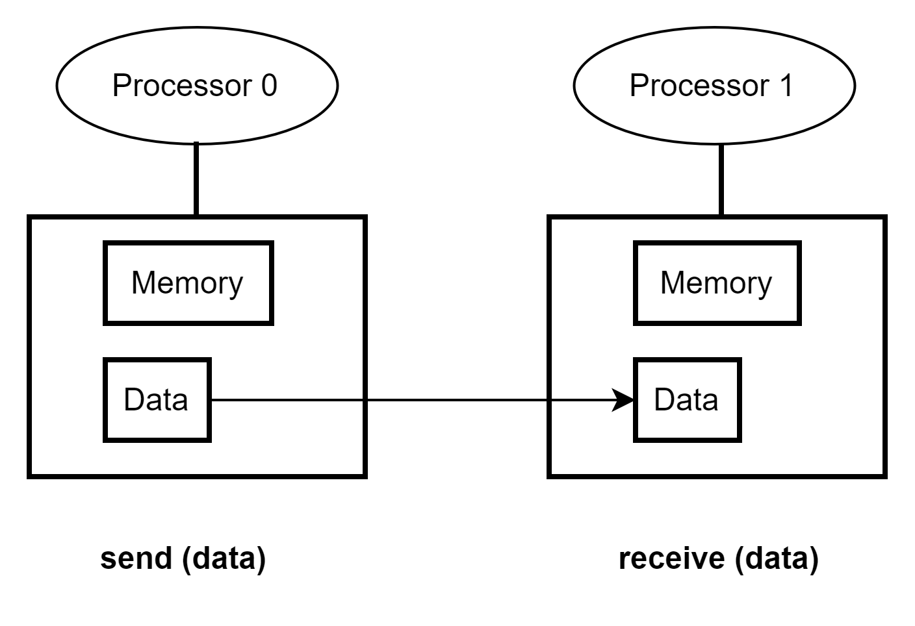
Message Passing Programming Cont…

Slide 30
Message Passing Programming Modes
Different communication modes that can be used for message passing programming are:
Synchronous/asynchronous
Blocking/non-blocking
Buffered/unbuffered

Slide 31
Message Passing Programming Modes Cont…
Non-blocking: A routine is non-blocking if it is guaranteed to complete regardless of external events (e.g., the other processors). Example: A send is non-blocking if it is guaranteed to return whether or not there is a matching receive.
Blocking: A routine is blocking if its completion (return of control to the calling routine) may depend on an external event (an event that is outside the control of the routine itself). Example: A send is blocking if it does not return until there is a matching receive.

Slide 32
Message Passing Programming Modes Cont…
Asynchronous: A routine is asynchronous if it initiates an operation that happens logically outside the flow of control of the calling process. The important practical distinction is whether the program may be required to check for completion of the operation before proceeding.
Synchronous: A routine is synchronous if its operation happens within the flow of control of the calling process.

Slide 33
Message Passing Programming Modes Cont…
Buffered: A routine that uses buffered message passing is a program that sends and receives messages using a buffer. In this mode, messages are queued in the buffer until they are ready to be sent or received.
Unbuffered: A routine may be used to perform a specific message-passing task, such as sending or receiving a message between two processes. Does not use a buffer. Messages are sent and received immediately without any buffering. This mode is useful when low latency is required.

Slide 34
CS621 Parallel and Distributed Computing
Asynchronous/Synchronous Message Passing

Slide 35
Objectives
Understanding of Synchronous Message Passing.
Understanding of Asynchronous Message Passing.

Slide 36
Asynchronous/Synchronous Message Passing
Message-passing programs are often written using the asynchronous or loosely synchronous paradigms.
In the asynchronous paradigm, all concurrent tasks execute asynchronously.
In the loosely synchronous model, tasks or subsets of tasks synchronize to perform interactions. Between these interactions, tasks execute completely asynchronously.

Slide 37
Synchronous Message Passing
A synchronous communication is not complete until the message has been received.
Completes once ack is received by sender.
Communication upon synchronization.
Hoare’s Communicating Sequential Processes (1978).
BLOCKING send and receive operations.
Unbuffered communication.
Several steps in protocol- synchronization, data movement, completion.
Delays participating processes.

Slide 38
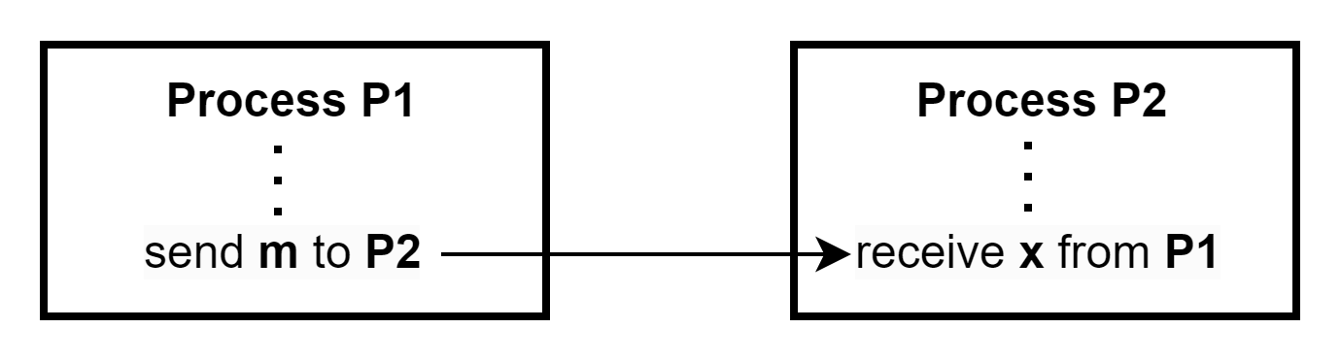
Synchronous Message Passing

Slide 39
Asynchronous Message Passing
Asynchronous Communication: An asynchronous communication completes before the message is received. It has three modes:
Standard send: completes once the message has been sent, which may or may not imply that the message has arrived at its destination.
Buffered send: completes immediately, if receiver not ready, MPI buffers the message locally.
Ready send: completes immediately, if the receiver is ready for the message it will get it, otherwise the message is dropped silently.

Slide 40
Asynchronous Message Passing
Buffered communication
May increase concurrency (e.g. producer/consumer).
May increase transit time.
Send operation
Send operation completes when message is completely copied to buffer.
Generally non-blocking but will block if buffer is full.
Receive operation – two flavors
BLOCKING
Receive operation completes when message has been delivered.
NON-BLOCKING
Receive operation provides location for message.
Notified when receive complete (via flag or interrupt).

Slide 41
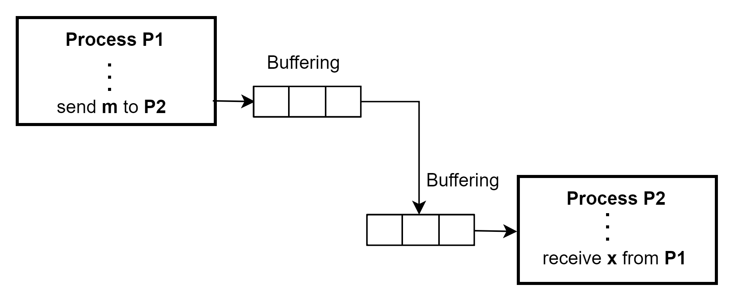
Asynchronous Message Passing

Slide 42
CS621 Parallel and Distributed Computing
Benefits of the Message Passing Interface

Slide 43
Objectives
Understanding of Benefits of MPI.

Slide 44
Benefits of the Message Passing Interface
Standardization - MPI is the only message passing library which can be considered a standard. It is supported on virtually all HPC platforms. Practically, it has replaced all previous message passing libraries.
Portability - There is no need to modify your source code when you port your application to a different platform that supports (and is compliant with) the MPI standard.

Slide 45
Benefits of the Message Passing Interface Cont…
Performance Opportunities - Vendor implementations should be able to exploit native hardware features to optimize performance.
Functionality - Over 115 routines are defined in MPI-1 alone.
Notes:
For more information about MPI performance see the MPI Performance Topics (http://www.llnl.gov/computing/tutorials/mpi_performance) tutorial.

Slide 46
Benefits of the Message Passing Interface Cont…
Availability - A variety of implementations are available, both vendor and public domain.
Scalability- MPI is designed to scale to large numbers of processors, which makes it well-suited for high-performance computing.
Notes:
For more information about MPI performance see the MPI Performance Topics (http://www.llnl.gov/computing/tutorials/mpi_performance) tutorial.

